Slide 1

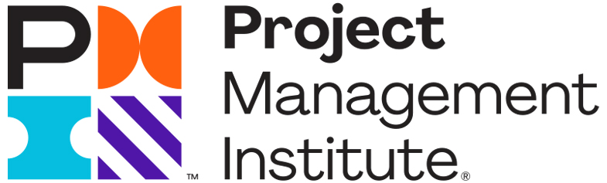
Meet the Growing Need for Project Managers in the Global Economy
How Certified Associate In Project Management (CAPM®) Certification Can Help You?

Slide 2
State of the market 2022¹
102 mil
90 mil
There are currently 90 million project management-oriented employment (PMOE) around the world
By 2030, the global economy will need 102 million people for PMOE
But there’s a problem …
¹ Project Talent Gap: Ten-Year Employment Trends, Costs, and Global Implications. Management Institute. 2021.
2022
2030

Slide 3

The talent gap
The problem is the gap between growing opportunities in PMOE and the availability of talented people to fill those roles¹
Here’s why:
12 million new jobs in PMOE globally over the next 8 years
13 million people in PMOE will retire by 2030
¹ Project Management Institute. 2021. Talent Gap: Ten-Year Employment Trends, Costs, and Global Implications.

Slide 4
The talent group
12 million new jobs + replacing 13 million retirees = 25 million new project managers by the end of the decade
25 million new project managers by the end of the decade
To meet the demand, at least 2.3 million more people must enter PMOE each year just to keep up
Some of those new project managers could come from within organizations

Slide 5

Organizational needs
Senior leaders say their organizations often struggle to bridge the gap between strategic planning and day-to-day implementation¹
¹ PMI 2017. PMI’s pulse of the profession 2017. Success Rates Rise . Transforming the high cost of low performance.

Slide 6

Organizational needs
Nearly 80% of business leaders cited capability building as “very” or “extremely” important to their organization’s growth in a post-COVID-19 pandemic environment²
² McKinsey Accelerate. November 23, 2020. Rethink Capabilities to Emerge Stronger from COVID-19.

Slide 7
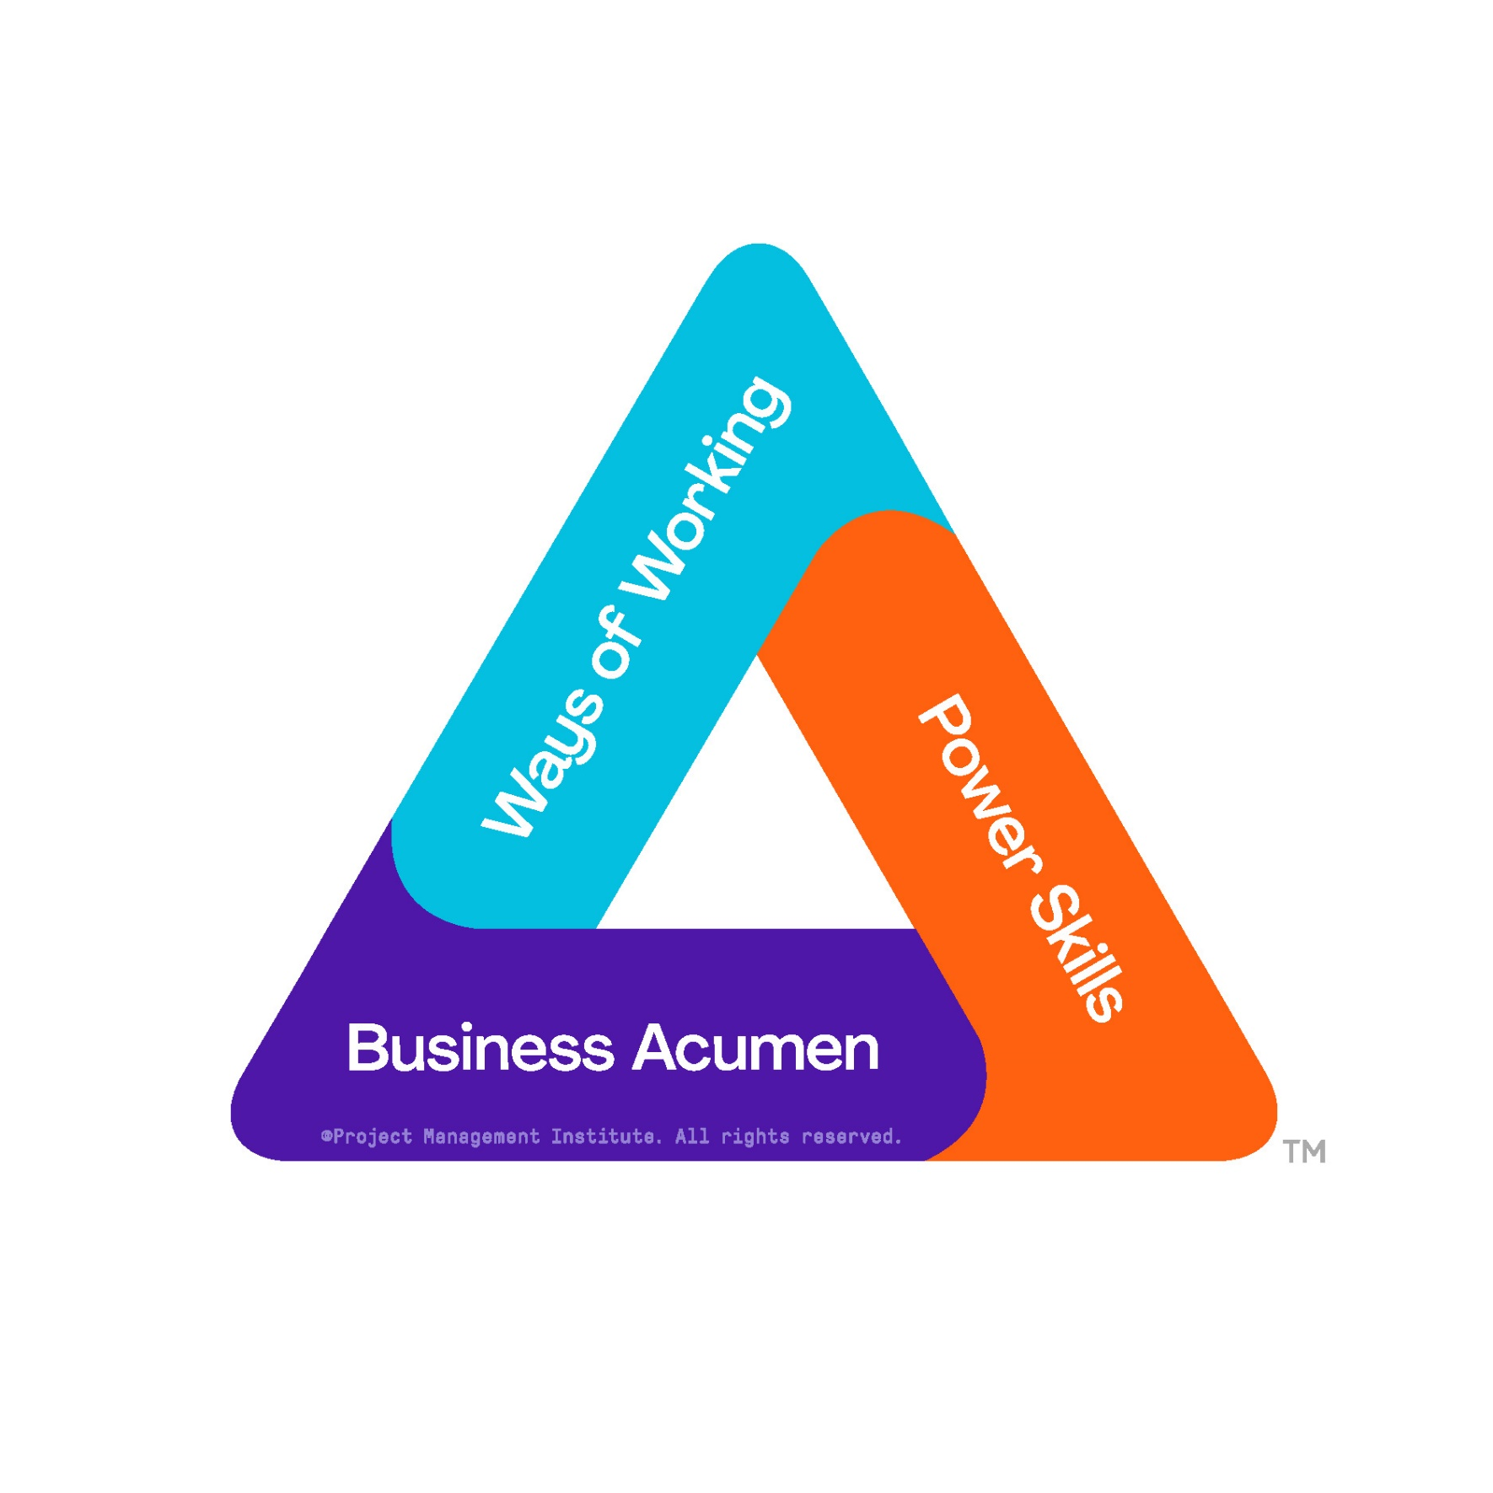
It is important for organizations to develop these skill areas

Slide 8

It is important for organizations to develop these skill areas
Ways of Working
Master ways of working to apply the right technique at the right time, deliver winning results, and drive continuous transformation.
Business Acumen
Master business acumen to keep in tune with the organization’s strategy, operations, and function for a holistic understanding.
Power Skills
Master power skills to motivate action and
deliver artfully.
Essential skills: Active listening, communication, empathy + more
Leadership styles: Coaching, delegating, supporting + more

Slide 9
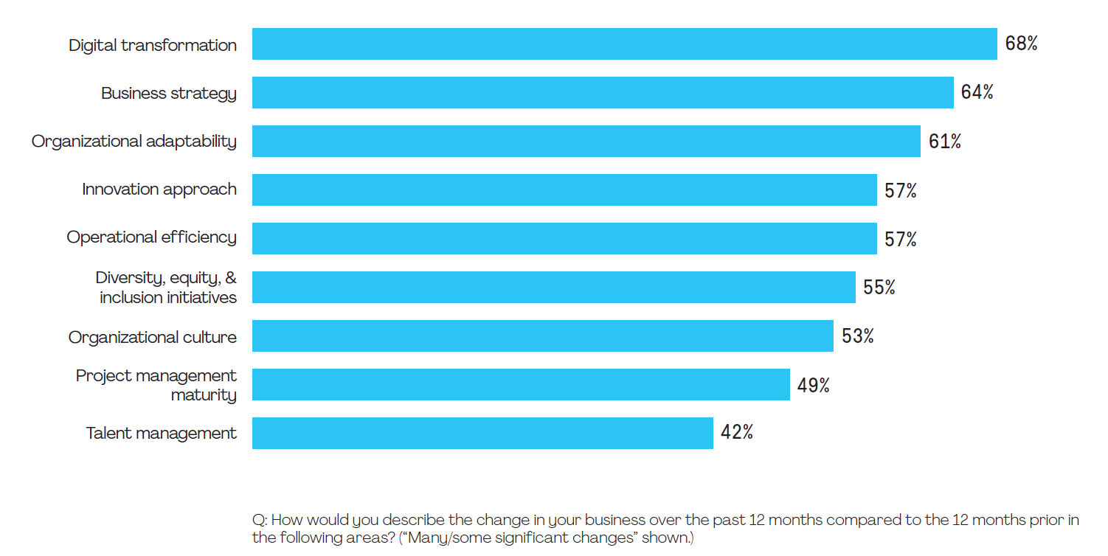
Major market changes continue with a focus on value
The pandemic accelerated the pace and scale of digitalization exponentially, with a big impact on talent and the need to upskill and reskill.
Notes:
The pandemic accelerated the pace and scale of digitalization exponentially, with a big impact on talent and the need to upskill and reskill.

Slide 10
Most important factor responsible for failure
Lack of clearly defined and/or achievable milestones and objectives to measure progress
37%
Strategic initiatives grow and redirect the organization.
A majority of senior leaders acknowledge that their organizations often struggle to bridge the gap between strategy formulation and its day-to-day implementation.
Poor communication
19%
Lack of communication by senior management
18%
Employee resistance
14%
Insufficient funding
9%
Other
4%
Source: PMI 2017. PMI’s pulse of the profession 2017. Success Rates Rise . Transforming the high cost of low performance.

Slide 11
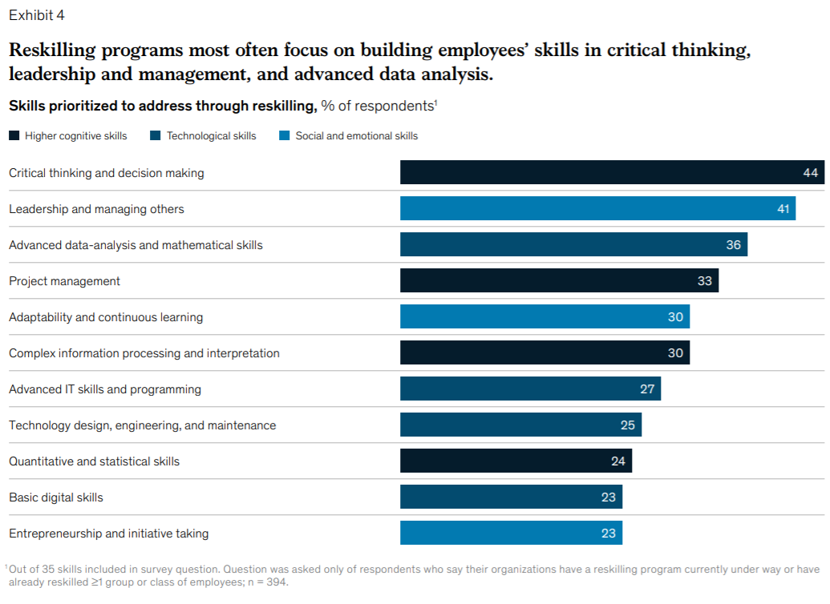

Upskilling project management
SOURCE: 2020 MCKINSEY & COMPANY
https://www.mckinsey.com/business-functions/organization/our-insights/beyond-hiring-how-companies-are-reskilling-to-address-talent-gaps
Source: 2020 McKinsey & Company
https://www.mckinsey.com/business-functions/organization/our-insights/beyond-hiring-how-companies-are-reskilling-to-address-talent-gaps
Notes:
We first came across these findings because they identify project management as a key skill that will grow in demand…
invariably touch on critical thinking – this is still an essential example of what we call a “Power Skill” for managing technology and AI related projects.
https://www.mckinsey.com/business-functions/organization/our-insights/beyond-hiring-how-companies-are-reskilling-to-address-talent-gaps

Slide 12

The best project managers are evolving now

Slide 13
The best project managers are evolving now
Using new technology
Focusing on influencing outcomes
Working on building relationships
Achieving the strategic goals of their organization

Slide 14
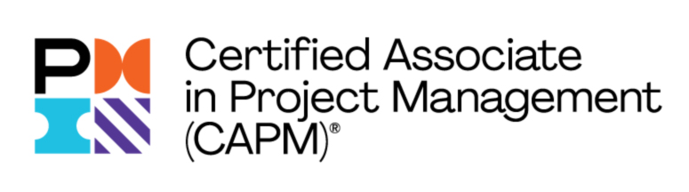
How to get Started in Project Management?

Slide 15
Certified Associate in Project Management (CAPM) ® is the starting point
The Certified Associate of Project Management (CAPM) is a globally recognized credential that opens the door to opportunities at every stage of your career in the field of project management.

Slide 16
What does CAPM signify?
Shows you have the understanding of the fundamental knowledge which includes predictive project management, agile principles and business analysis.

Slide 17
Why earn CAPM® Certification?
Qualify for much demand entry-level project management positions like project coordinator associate and junior project manager.
Everyone benefits from understanding project management fundamentals. All organizations and employees work on projects. Build on your skillset in your current career.
Build a future with a career in project management. Earning your CAPM® certification automatically meets the 35 hours of project management education and training required to sit or the PMP® exam.

Slide 18
Updated Exam Features
The updated Certified Associate in Project Management (CAPM)® will distinguish you in the job market and enhance your credibility. The certification recognizes your foundational knowledge which includes predictive project management, agile principles and business analysis.
4 Domain areas
  Project Management Fundamentals and Core Concepts
  Predictive Plan-Based Methodologies
  NEW Agile Frameworks/Methodologies
  NEW Business Analysis Frameworks
Pilot Animations and Comic Strips Items (English exam only)
10-minute break in the exam
Exam to be available in in English
  English
  Spanish
  French
  Arabic
  German
  Portuguese-Brazilian
  Japanese
  Chinese Simplified
150 questions
3-hour exam
Cost
  USD$225 Member (Zone A)
  USD$300 Non-Member (Zone A)
Earn 15 PDU’s to maintain credential
Earn a digital badge
Available both via Computer Based Testing (CBT) and Online Proctored Testing (OPT)

Slide 19
^{CAPM® Exam Eligibility}
Have a secondary degree, such as a high school diploma, GED (general educational development) or global equivalent
Have at least 23 contact hours of project management education completed before the exam

Slide 20
How do I obtain 23 contact hours to sit for the CAPM® exam?
[Chapter logo]
[DESCRIPTION OF [ CHAPTER TRAINING
[DATE & TIME]

Slide 21
Q&A

Slide 22
Thank you!

